Slide 1
COMMITTEES, Teams and Group Decision making
Session 30

Slide 2
Committee
Comprised of people who come together to review issues propose recommendation for action is called COMMITTEE.
Ex: Srikrishna Committee on Telangana or the Committee for Consultations on the Situation in Andhra Pradesh is a committee headed by former chief justice B. N. Srikrishna to look into the demand for separate statehood for Telangana or keep the State united in the present form, Andhra Pradesh.

Slide 3
Teams
A small group of people working on the same problem or sub problem in a project the team member depend on one another to do their task is called TEAM.
Ex: Some examples include developer teams at a tech start up or the sales team at a marketing agency. Departmental teams are permanent and typically work on ongoing projects or goals.

Slide 4
Groups
A set of people who are assigned to common task and work individually to accomplish there assignment are called GROUP.
Ex: A regional sales team responsible for selling insurance and other financial services to local citizens would be a prototypical group. In this so-called team, each sales rep has individual revenue and profitability goals for an assigned geographic territory. An individual’s ability to achieve these goals does not depend on what the other sales reps do; instead it is completely dependent upon that person’s own performance.

Slide 5
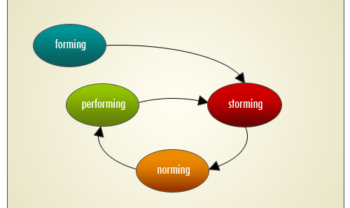
Four stages in Group processes

Slide 6
Board of Directors
A board of directors is a group of people who jointly supervise the activities of an organization, which can be either a for-profit business, nonprofit organization, or a government agency.
A board of directors is a team of people elected by a corporation's shareholders to represent the shareholders' interests and ensure that the company's management acts on their behalf. The head of the board of directors is the chairman or chairperson of the board

Slide 7
Line and Staff Committees
The basis of line and staff committees is authority. A committee which has authority to make decisions to be implemented by the subordinates is a line committee and a committee which does not make decisions but only assists superiors and advices and counsels them is a staff committee.
It enables line managers to effectively perform the managerial functions. The authority of staff committee to its superiors is advisory in nature.

Slide 8
Ad hoc and Standing Committee
The basis for forming ad hoc and standing committees is time frame. Committees which are formed for a specific purpose and dissolve after the purpose is achieved are ad hoc or temporary committees. For example, company wants to launch a new product and conduct a market survey.
A committee can be formed for this purpose which shall function till the survey is completed. Once done and the product launched, the committee stands dissolved. A committee which lasts for long duration of time is standing or permanent committee. These committees provide advisory functions to the chief executives.

Slide 9
Formal and Informal Committees
The basis of formal and informal committees is their position on the organization chart. Committees formed according to formal procedures with assigned duties, power and authority are known as formal committees. They are formally depicted on the organization charts and are permanent committees.

Slide 10
Reasons for using Committees and Groups
Group deliberation and Judgment
Fear of too much authority in a single person
Representation of Interested groups
Coordination of Departments, Plans and Policies
Transmission and sharing of information
Consolidation of Authority
Motivation through participation

Slide 11
Successful operation of Committees and Groups
Authority
Size
Membership
Subject matter
Chairperson
Minutes
Cost-Effectiveness

Slide 12
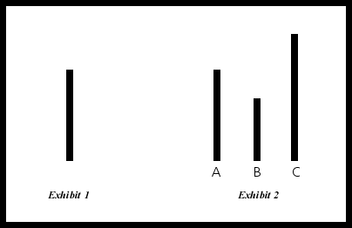
Asch’s experiment on group pressure

Slide 13
Conclusions of experiment
When they were interviewed after the experiment, most of them said that they did not really believe their conforming answers, but had gone along with the group for fear of being ridiculed or thought "peculiar.
A few of them said that they really did believe the group's answers were correct.
Apparently, people conform for two main reasons: because they want to fit in with the group (normative influence) and because they believe the group is better informed than they are (informational influence).

Slide 14
A special kind of Group: The Focus Group
A focus group is a small, but demographically diverse group of people and whose reactions are studied especially in market research or political analysis in guided or open discussions about a new product or something else to determine the reactions that can be expected from a larger population.

Slide 15
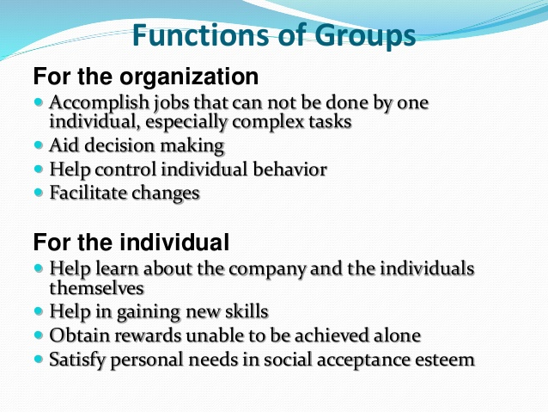

Slide 16
Advantages of Group
Improves Morale By Promoting a Sense of Ownership
Builds Trust and Enhances Relationships
Greater Flexibility for the Organization
Fosters Creativity and Innovation

Slide 17
Types of teams
Self-managing teams
Virtual teams
Cross-functional teams

Slide 18
Team building
Team building is the process of turning a group of individual contributing employees into a cohesive team. A team is a group of people organized to work together interdependently and cooperatively to meet the needs of their customers by accomplishing their purpose and goals.

Slide 19
Conflict
Conflict may arise between individuals, between groups, and between organization and its environment.
There can also be resentment toward “free riders”, individuals who do not contribute their fair share yet share in group rewards.

